Slide 1
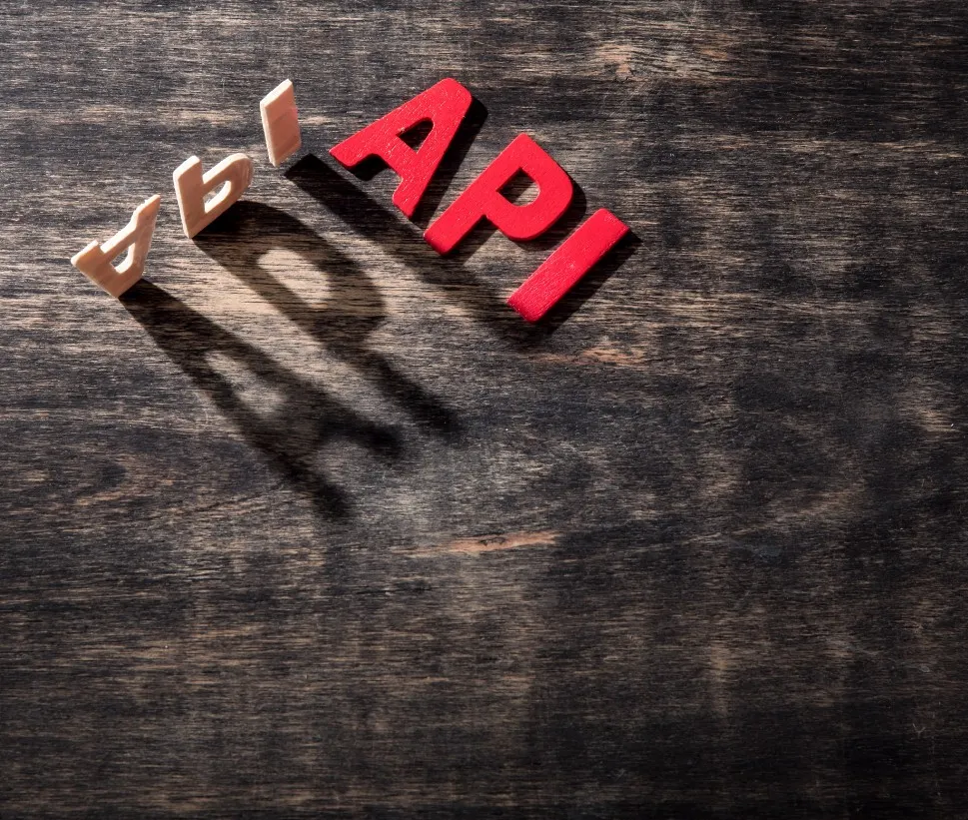
Application Program Interface(API)
By Ari Bannish

Slide 2

Defining APIs
APIs define interactions between two systems.
Is an abstraction of a system.
An API sits on top of already built system without internal integration.
An API is a contract
An API can be thought of as a contract of use. They define:
The operations for use.
Communication form to be used
Data form to be used.

Slide 3

More API Theory
Differing API Access Levels
Private – Organization access only
Protected – Access is shared with partners
Public – Anyone can access the API
Data Forms
XML – Extendable Markup Language
Data is tagged and contained within the tags.
JSON – JavaScript Object Notation
Key value pairs are used to represent data.
YAML – Yet Another Markup Language
Like JSON except whitespace matters.

Slide 4
Remote APIs
SOAP (Simple Object Access Protocol)
REST ( Representational Sate Transfer)
Data Representation
XML
Communication
HTTP(S) or SMTP
Defines a protocol
A series of steps taken for communication.
Data Representation
JSON
Communication
HTTP or HTTPS
Defines architectural constraints
Defines 8 constraints
Client-server model
Stateless
Cacheable
Layered
Uniform interface – 4 addendums
Notes:
4 Addendums
Resources indemnification in request
Resources are identified in the requests are separated from the representation returned.
Resource manipulation
Clients receive enough information to modify the state of the resource.
self-descriptive messages
Each message returned to the client must have enough information to be able to process the information
Hypermedia
After accessing a resource, the client sould be able to discover through hyperlinks all other actions that are currently available.

Slide 5

REST API Demo

Slide 6
Why is this important ?
Access Security
Databases, and internal systems are not exposed.
Abstraction
Application doesn’t need to be modified. Rather a second layer performs the work.
Redundancy
If an API host fails, then the backend system stays in operation.
High Availability
APIs can perform load balancing, offering up higher availability.
Scalable
Small applications can be scaled to enterprise size.
Used in development
SOAP
SalesForce – complete control
IBM – product management
AWS API Gateway – provides HaaS control & SaaS control
REST API
YouTube – information lookup
VMWare – complete control
AWS API Gateway – provides HaaS control & SaaS control
Notes:
HaaS -> Hardware as a Solution
Software as a Solution
SalesForce -> provides customer relation management service

Slide 7
Q & A
Notes:
SOAP wraps data into an envelope
Envelope
identifies the information as a SOAP message
Body
Is placed inside the envelope and contains message information in XML format

